Slide 1



CAPSTONE PROJECT NBA DATA ANALYSIS WITH FOCUS ON THE LA LAKERS (2003 – 2022)
AMUSA IDRIS ADEBOLA

Slide 2

AGENDA
PROJECT/GOALS
PROJECT IMPORTANCE
PROCESS
RESULTS
CHALLENGES
FUTURE GOALS

Slide 3
PROJECT/GOALS

Slide 4
PROJECT GOALS
This project involves the analysis and visualization of NBA data with a particular focus on LA Lakers. The dataset covers the years 2003-2022 and is sourced from the NBA stats website.
I analyzed 5 datasets (csv files), listed below:
games.csv : all games from 2004 season to last update with the date, teams and some details like number of points, etc.
games_details.csv : details of games dataset, all statistics of players for a given game.
players.csv : players details (name).
ranking.csv : ranking of NBA given a day (split into west and east).
teams.csv : all teams of NBA.

Slide 5
PROJECT IMPORTANCE

Slide 6
PROJECT IMPORTANCE
This project on basketball game statistics is important for various reasons:
Performance Analysis: Assess player and team performance for improvement.
Player Development: Tailor training programs to individual player needs.
Team Management: Make informed decisions on player rotations, substitutions, and team composition.
Scouting and Recruitment: Evaluate opponents and identify potential recruits.
Injury Prevention: Monitor player workload for effective injury prevention.
Sponsorship and Marketing: Identify high-performing teams and players for sponsorships and partnerships.
Educational Opportunities: Provide learning opportunities in data science, analytics, and sports management.

Slide 7
PROCESS

Slide 8
PROCESS – Python – Data
Import some python libraries i.e. matplotlib, seaborn, pandas, datetime etc. to help with data visualization.
Read the 5 datasets csv files, get their dimensions (shape) and put them into data frames.
Generate several statistics, to include, wins, points, assists, rebounds, home and away performances etc, about LA Lakers.
Create a list for LA Lakers team performances in relation to opposition performances over a period to analyze team strength.

Slide 9
PROCESS – Python – EDA
Import the Python libraries i.e. matplotlib, seaborn, pandas, datetime etc. to help with exploratory data analysis.
Read the merged data csv file i.e. LALData.csv, get the dimension (shape) and put them in data frames.
For my team of choice i.e. LA Lakers, and their opponents, generate different statistics like Team_Points, Opposition_Points, Team_assists etc, and put into data frames.
Generate histoplots, boxplots & lineplots showing relationships and seasonal trends of key NBA game statistics.

Slide 10
PROCESS – Python – Model
Import Python libraries i.e. sklearn, pandas, numpy, matplotlib, seaborn etc. to help build a regression model.
Drop columns with missing values.
Declare feature vector and target variable. (put details)
Split the data intro train and test.
Generate the regression model.

Slide 11
PROCESS – Tableau
Connect the data file.
Detect different data types in the data and make corrections to them.
Build at least 5 different visualizations, including Date and time, Analytical visuals (Forecasting - Clustering) and Show Me tables, to learn more about the dataset.
Try to find an interesting pattern, meaningful key points, trend, outlier, etc. from the data used in the above steps.
Create the dashboard.
Get ready to present the dashboard.

Slide 12
RESULTS

Slide 13
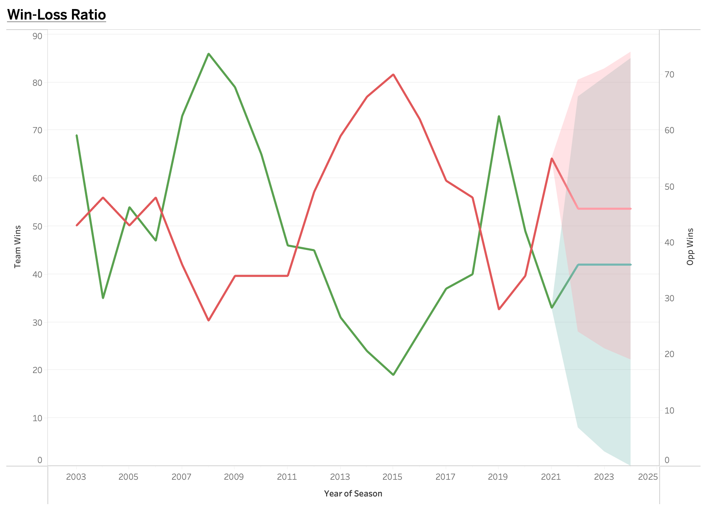
RESULTS – Win/Loss Ratio
From the dataset, LA Lakers had their most wins (86) in a single NBA season in 2008. Interestingly, even though they won the NBA Western conference, they lost the NBA championship to the Boston Celtics.
Conversely, they had their fewest wins (19) in 2015 where they finished bottom of the NBA Western conference.

Slide 14
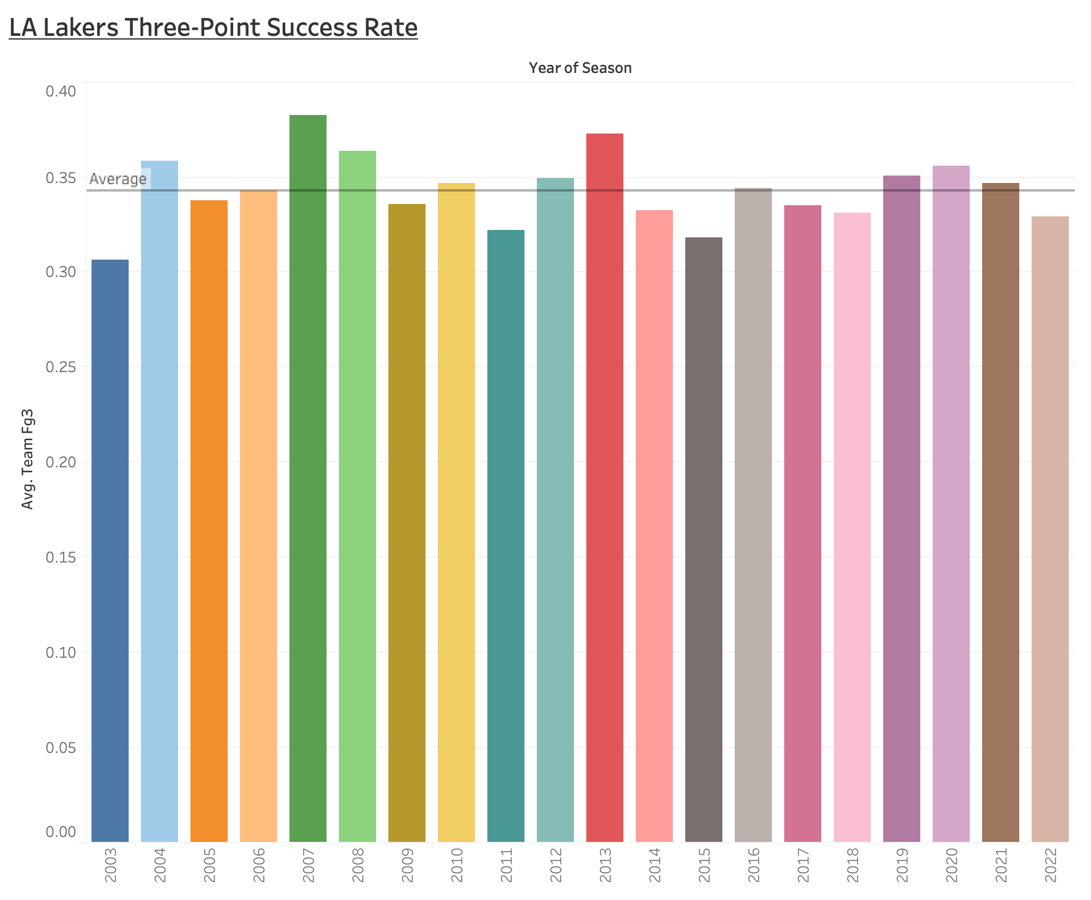
RESULTS – 3pt. Success rate
The LA Lakers had their highest 3-point success rate (38.19%) in 2017 and had their lowest 3-point accuracy (30.64%) in 2003. They have an average success rate of 34.28% over the seasons.

Slide 15
Learnings from the Data
LA Lakers had their most NBA wins in a calendar year (86) in 2008. Conversely, they had their fewest wins (19) in the 2015.
The LA Lakers had their highest 3-point success rate (38.19%) in 2017 and had their lowest 3-point accuracy (30.64%) in 2003.
The LA Lakers attempted their highest amount of 3-point shots (42) in 2017 and attempted their lowest 3-point shots (26) in 2011.

Slide 16
DASHBOARD

Slide 17
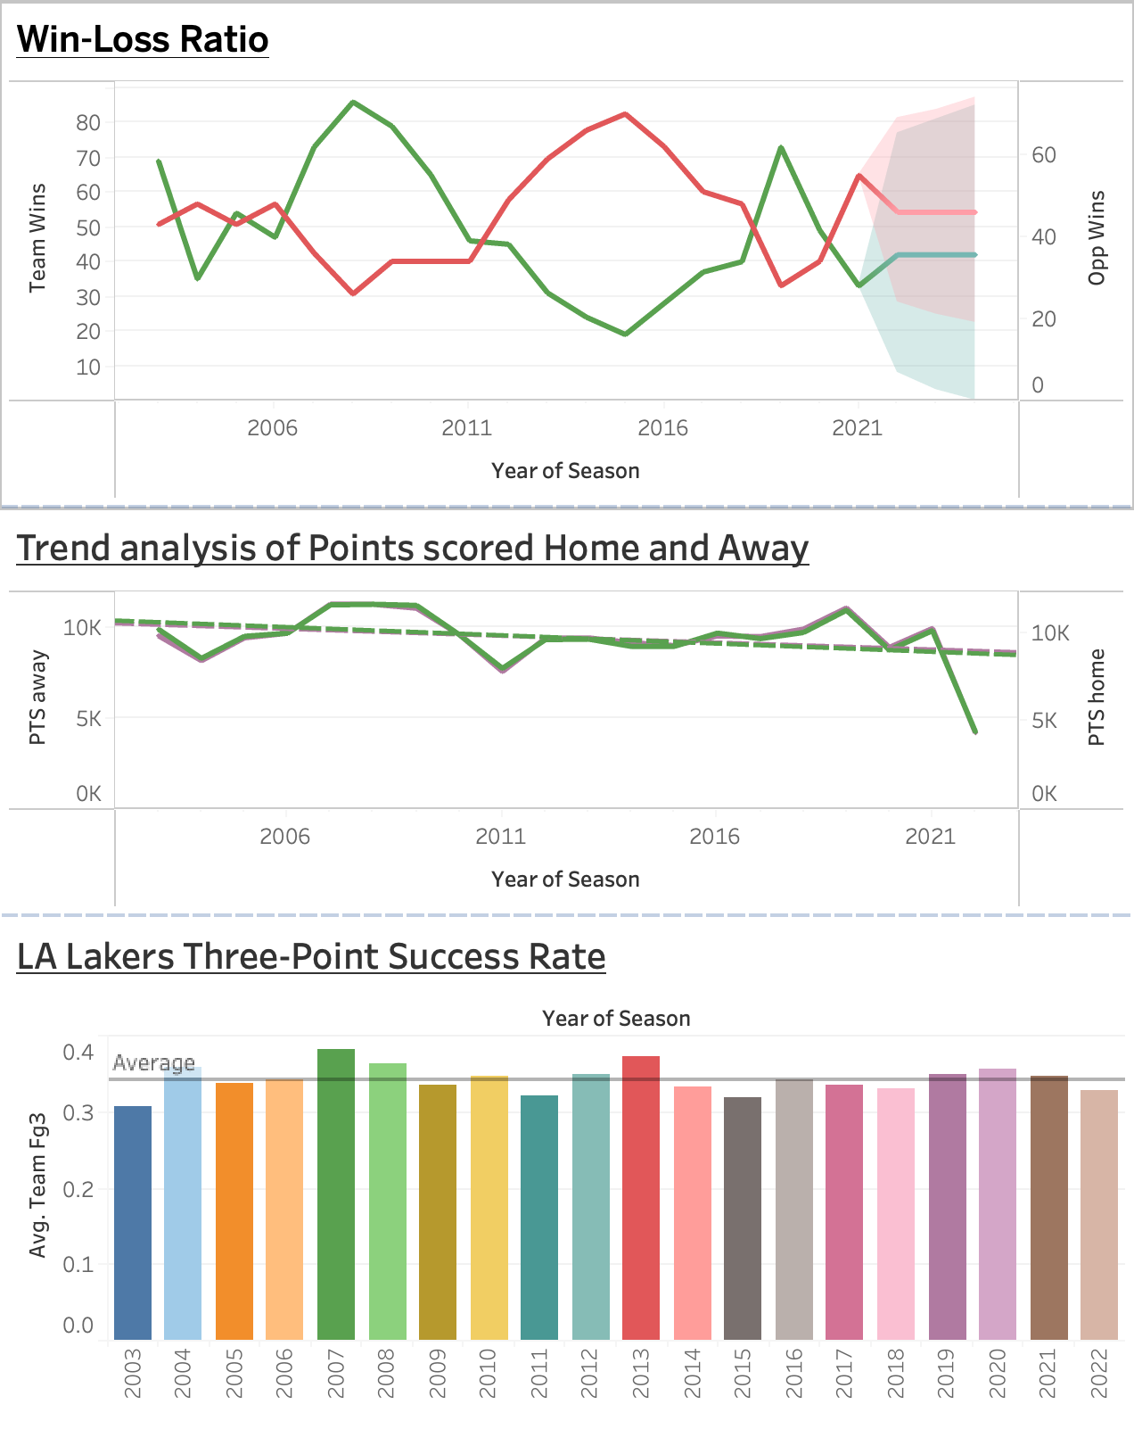
Dashboard

Slide 18
CHALLENGES

Slide 19
CHALLENGES
Data type correction required after EDA and modelling on Jupyter lab.
Forecasting Reliability: had to forecast even with 2022 data been incomplete (ended at the close of the 2021/2022 season).
Dashboard Design Complexity: Designing an effective and user-friendly dashboard to meet diverse stakeholder needs and preferences.

Slide 20
FUTURE GOALS

Slide 21
FUTURE GOALS: If I had more time
Explore additional features of the datasets for more comprehensive analysis.
Perform more visualizations to better interpret the data and get better deductions.
Refine visualizations and dashboard layout for better user experience.

Slide 22
References
https://www.tableau.com/trial/tableau-software
https://www.nba.com/stats
https://www.kaggle.com/datasets/nathanlauga/nba-games?resource=download

